Slide 1
E-RETAIL CUSTOMER ACTIVATION AND RETENTION
Submitted by
Yashna Shah

Slide 2
Customer Retention
Customer retention is the mirror image of customer defection.
Customer Retention is all about how well you are building relationships and drawing existing customers back for subsequent purchase.
Customer retention is a business’s ability to keep existing customers and continue to generate revenue from them.
customer retention allows a business to increase the profitability of an existing customer and maximize their lifetime value (LTV).

Slide 3
CONCEPTUAL BACKGROUND OF THE DOMAIN PROBLEM
Customer satisfaction has emerged as one of the most important factors that guarantee the success of online store; it has been posited as a key stimulant of purchase, repurchase intentions and customer loyalty. A comprehensive review of the literature, theories and models have been carried out to propose the models for customer activation and customer retention. Five major factors that contributed to the success of an e-commerce store have been identified as: service quality, system quality, information quality, trust and net benefit.

Slide 4
BUSINESS PROBLEM FRAMING
The objective is to perform extensive data analysis on a given dataset and produce valuable insights that will help in customer retention.

Slide 5
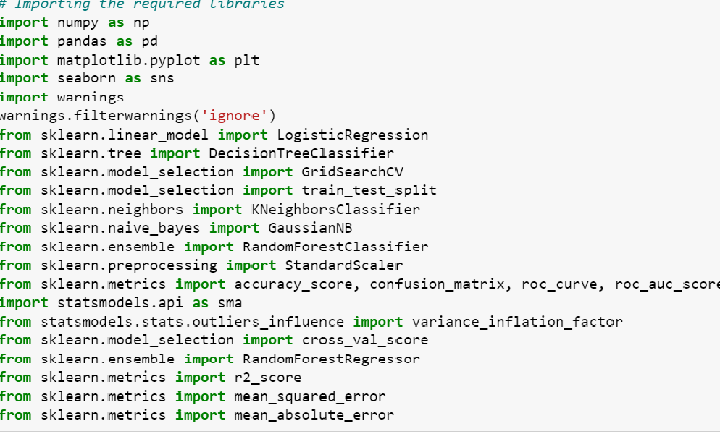
DATA SOURCES
IMPORTED REQUIRED LIBRARIES

Slide 6
DATA source
The dataset consists of 71 features and 269 rows.
Data set doesn’t contains Null values. We treated them using the domain knowledge and our own understanding.
Extensive EDA has been performed to gain relationships of important variable and price.
Data contains one numerical and all others as categorical variable. We handled them accordingly.
We built Machine Learning models and determined the optimal values of Hyper Parameters.
We found important features which affect the price positively or negatively.

Slide 7
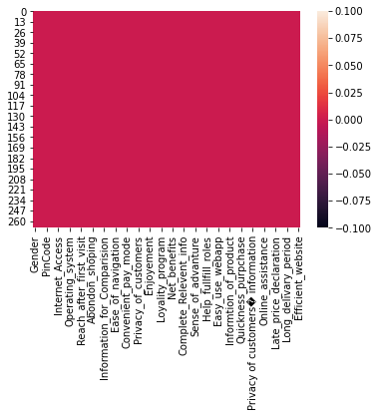
Contd…
CHECKING FOR NULL VALUES
There are no Null VALUES in our dataset.

Slide 8
Exploratory data analysis
During EDA we have first renamed our columns name
After changing name we will see shape of the data and check the null values present in the data .
Data is not having any null values and all the data is object type.
As the data is object type we will mostly perform count plot.

Slide 9
Contd..
Checking correlation among features
The highly positive correlated column is Value_of_money.
The most negatively correlated column is Longer display time.
Perceived trustworthiness has zero correlation with target variable.

Slide 10

Correlation matrix

Slide 11
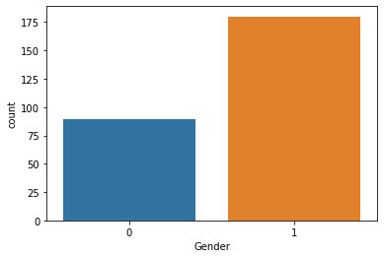
DATA VISUALIZATION AND ANALYSIS
GENDER
Here we can see there are more no of female shoppers than male.

Slide 12
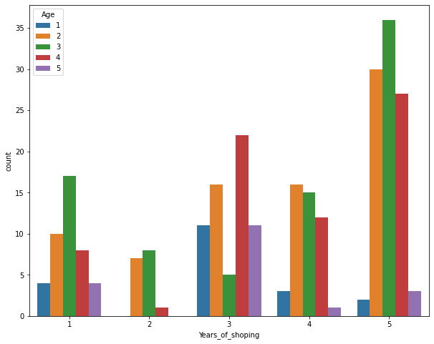
Contd..
ONLINE RETAILING
Maximum no of people are shopping online for more than 4 years, excluding the age group of less than 20 years and above 50years.

Slide 13
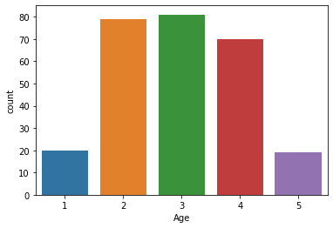
Contd..
AGE
Maximum online shoppers are from the age group 31-40 Years. More than 75 percent of online shoppers lies between 21-50 years old. Numbers for less than 20 years and above 51 are less, which indicates these age group rarely use online shopping.

Slide 14
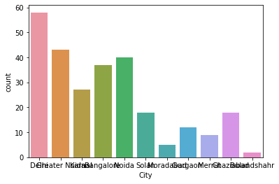
Contd..
CITY
Delhi has highest number of customers who shop online. Graph also shows that most of the customers are from Delhi, Greater Noida, Noida, Banglore and Karnal.

Slide 15
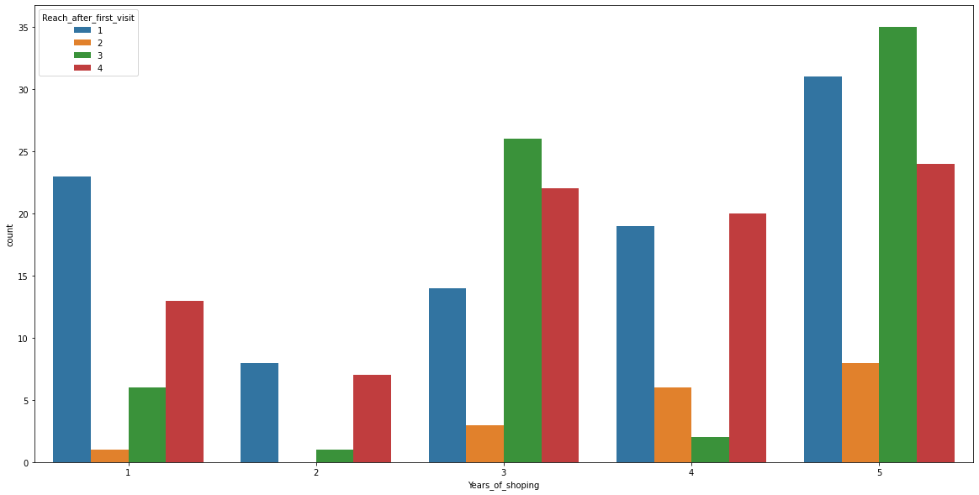
Contd…
Here we can observe that people shopping more than 3 yrs use link,url but not the app for shopping. This shows that online brands should update their platforms.

Slide 16
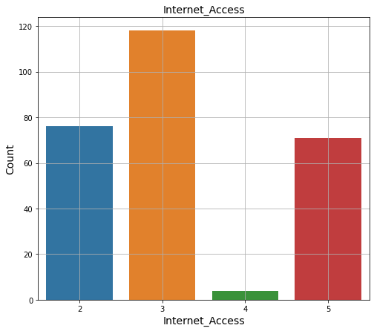
Contd…
INTERNET ACCESS
Majority of the shoppers are using Mobile internet for shopping online.

Slide 17
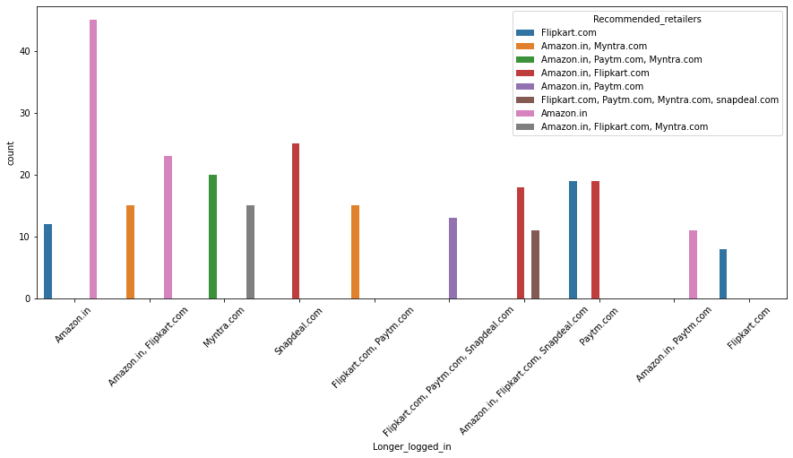
Contd..
Collecting all the negative remarks about a brand
RECOMMENDED RETAILERS

Slide 18
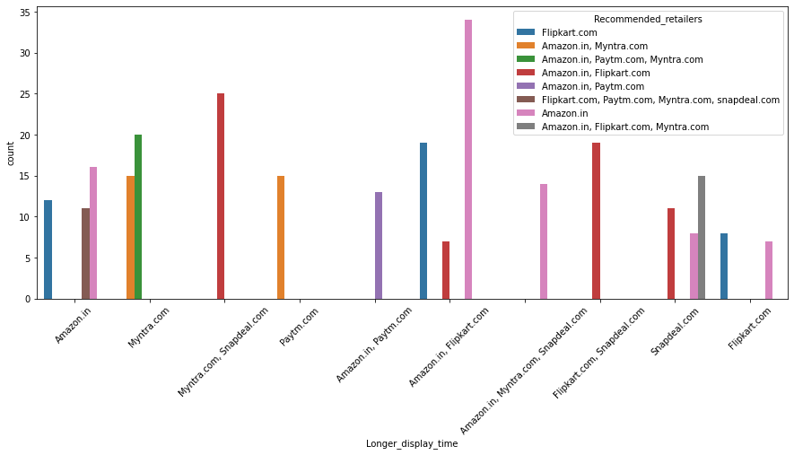
Contd..

Slide 19
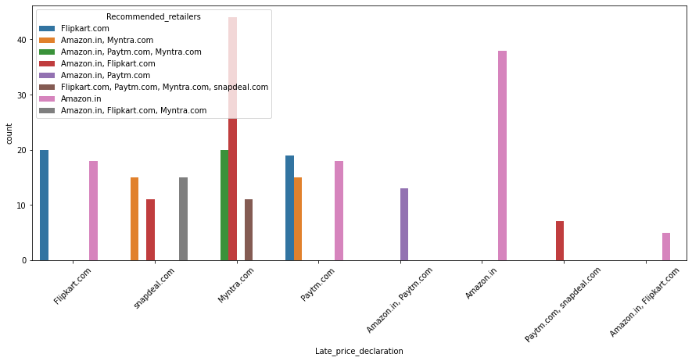
Contd..

Slide 20
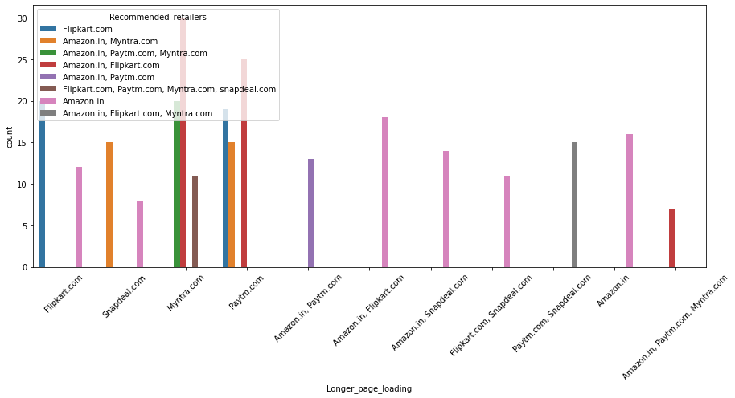
Contd..

Slide 21
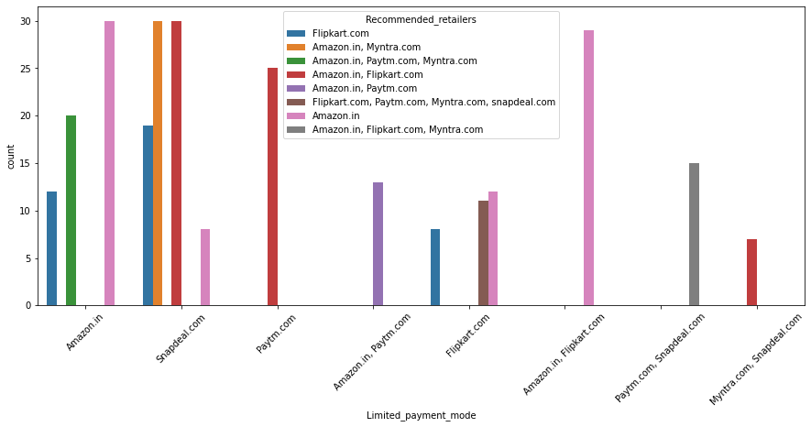
Contd..

Slide 22
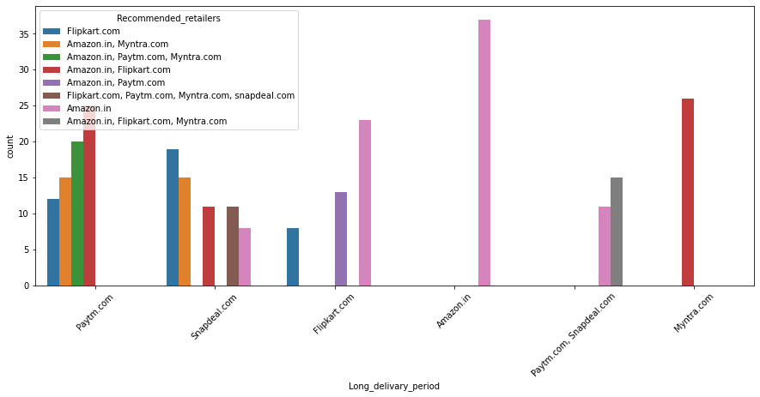
Contd..

Slide 23
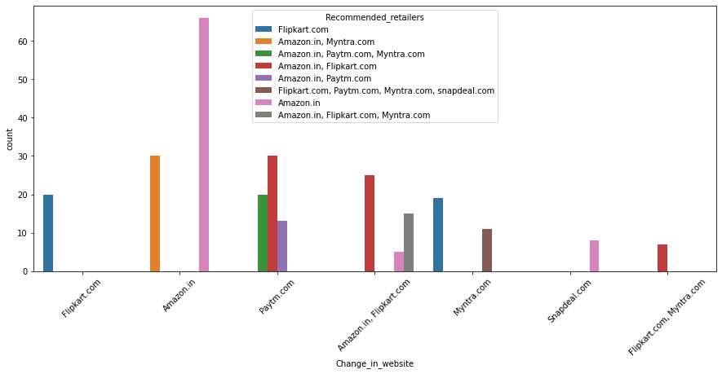
Contd..

Slide 24
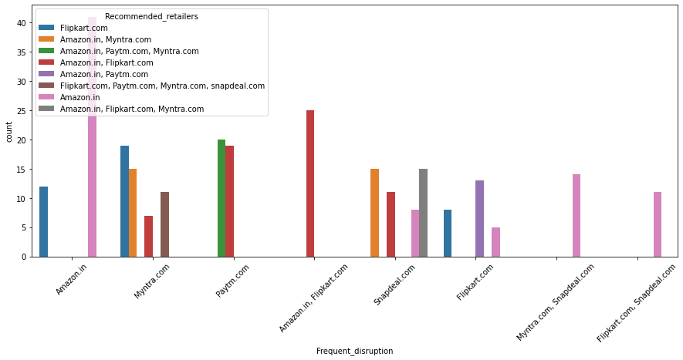
Contd..

Slide 25
ANALYSIS
From the above graphs, we can observe that customers are more loyal towards Amazon, Flipkart and Paytm.
Some of the customers have also given negative feedback and have referred to others.

Slide 26
INFERENCES
We can observe that Amazon and Flipkart are the most preferred sites for shopping by the customers.
Amazon is considered as the most customer friendly website as compared to others.
Amazon is the most shopped website for years and customers use debit / credit card among other payment methods.
Amazon performs well in Customer Retention with utilitarian value.
The websites which perform well in customer retention are Amazon and Flipkart as compared to other websites.

Slide 27
CONCLUSION
Female shoppers more than males overall
Most shopping age is 31-40 years
Most people are shopping from delhi in overall people shopping around 4 years
People made purchase in past years in less than 10 times
People mostly use mobile internet and smartphone buy from amazon
Screen size of mobile is 5.5 and others category and has windows OS mostly
People use google chrome and search engine channel to explore first mostly
People purchase via application and direct url mostly .
Customer use credit/debit cards mostly for their transactions in amazon
They abandon purchase sometimes only
They quit purchase because of better alternative offer and promo code if not available
People strongly agree that the content of the website should be readable easily.
People mostly strongly agree to the both hedonic and utilitarian values provided by the e-retail
Amazon and flipkart provides both hedonic and utilitarian values to the customers to make activation and retention. And they do best among others here
Myntra and paytm has longer page loading time
Snapdeal and paytm has longer delivery speed
Limited mode of payments in snapdeal
Amazon changed its webpage to upgraded one
Amazon is efficient in web design as before

Slide 28
Conclude
Hence, we can say that Amazon is the most recommended retailer as compared to others.

